Slide 1
Digital Portfolio
STUDENT NAME: C. Ashwini
REGISTER NO AND NMID: astvu30430424u18003
DEPARTMENT: Computer science
COLLEGE: Arignar Anna Govt. Arts College (W), Walajapet, Ranipet Dist
UNIVERSITY : TIRUVALLUR UNIVERSITY
1
Notes:
1

Slide 2
PROJECT TITLE
Frontend web development 🖥️
My Digital Portfolio
2

Slide 3


AGENDA
Problem Statement
Project Overview
End Users
Tools and Technologies
Portfolio design and Layout
Features and Functionality
Results and Screenshots
Conclusion
Github Link
3/21/2024 Annual Review
3

Slide 4

PROBLEM STATEMENT
The objective of this project is to design and develop a digital portfolio website that showcases my skills, achievements, and projects in an interactive and visually appealing manner.
The portfolio will be created using HTML, CSS, and JavaScript with separate coding files for structure, design, and functionality.
4

Slide 5

PROJECT OVERVIEW
It highlights two major projects:
1. Project 1 –
Learning Platforms Showcase Features links and logos of W3Schools and Edunet, two learning platforms I have used to enhance my technical knowledge.
2. Project 2 –
Interactive Quiz Application This project highlights my ability to use HTML, CSS, and JavaScript to create interactive and user-friendly applications.
5

Slide 6

WHO ARE THE END USERS?
1. Teachers / Instructors – to evaluate your skills, projects, and learning progress. 2. Employers / Recruiters – to check your technical ability, creativity, and problem-solving skills when you apply for jobs or internships. 3. Clients – if you are freelancing, they can see your past work before hiring you.
4. Peers / Classmates – to share knowledge, ideas, and collaborative learning. 5. The creator – to track your growth, reflect on your learning, and maintain a personal record of achievements.
6

Slide 7

TOOLS AND TECHNIQUES
Tools 1. HTML, CSS, JavaScript 2. Code Editors (VS Code, Sublime Text, Notepad++) 3. Graphics Tools (Canva, Photoshop, Figma) 4. Version Control (Git, GitHub) 5. Web Hosting Platforms (GitHub Pages, Netlify)
Techniques
1. Responsive Design
2. Colorful Effects & Animations
3. Navigation & Linking
4. Interactivity
5. Content Organization
7

Slide 8
POTFOLIO DESIGN AND LAYOUT
Design
Use colorful themes with proper contrast to highlight sections.
Apply consistent fonts and styles to maintain professionalism.
Include visual elements like logos, icons, and images to make it engaging.
Add animations and transitions for an interactive feel.
Layout
Header Section – Name, title, and navigation menu.
About Section – Short introduction and objectives.
Projects Section –Project 1: Learning platforms showcase (W3Schools & Edunet).Project 2: Interactive quiz with score display.
Skills Section – List of technical skills/tools used.
8

Slide 9
FEATURES AND FUNCTIONALITY
Features:
1.Attractive UI – colorful themes, animations, and responsive design.
2. Navigation Menu – easy movement between sections (Home, About, Projects, Contact).
3. Project Showcase – with links, images, and short descriptions.
4. Interactive Elements – quiz, hover effects, clickable buttons.
5. Multimedia Support – images, icons, and possibly videos.
Functionality:
1.Responsive Design – works on mobile, tablet, and desktop.
2. Interactive Quiz – users can attempt questions and view scores.
3. Link Integration – direct links to W3Schools and Edunet platforms.
4. Dynamic Effects – animations and transitions using CSS/JavaScript.
5. User Engagement – score display, clickable projects, and smooth scrolling.

Slide 10
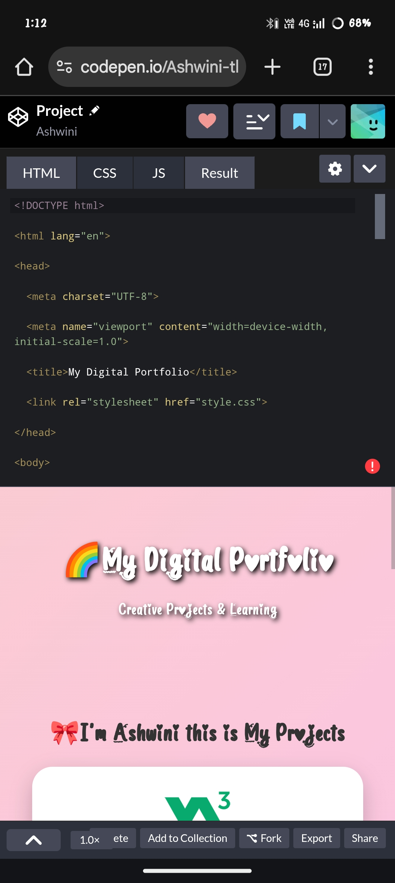

RESULTS AND SCREENSHOTS
Results of Digital Portfolio
1.Showcase of Skills – The portfolio successfully demonstrates my knowledge of HTML, CSS, and JavaScript through creative and interactive design.
2. Project Presentation – Both projects (Learning Platforms Showcase and Interactive Quiz) are displayed in a structured and user-friendly manner.
3. Enhanced User Experience – Colorful effects, animations, and responsive layout make the portfolio attractive and engaging.
4. Practical Application – The interactive quiz allows real-time user interaction and score display, proving the functionality of my coding skills.
5. Accessibility & Sharing – The portfolio can be easily shared with teachers, recruiters, or peers, making it a useful tool for academic and career growth.
3/21/2024 Annual Review
10

Slide 11
CONCLUSION
Conclusion
The digital portfolio has been an effective platform to showcase my learning, creativity, and technical skills. By integrating HTML, CSS, and JavaScript, I was able to design a colorful, interactive, and user-friendly portfolio. It not only highlights my projects—such as the Learning Platforms Showcase and the Interactive Quiz—but also reflects my ability to apply web development concepts in a practical way.
This project helped me improve my design thinking, coding, and problem-solving skills, while also creating a professional space that can be shared with teachers, recruiters, and peers. Overall, the digital portfolio fulfills its purpose as a creative representation of knowledge, projects, and achievements.
11

